Slide 1
EE319K Lab 2
For loops, while loops, if-then branching, subroutines, delays

Slide 2
Objectives
Basic Assembly programming
Designing and calling a delay subroutine
Using a negative logic input with a positive logic output
Utilizing the Logic Analyzer to verify LED toggling rate
Flash your program onto the microcontroller and confirms it works

Slide 3
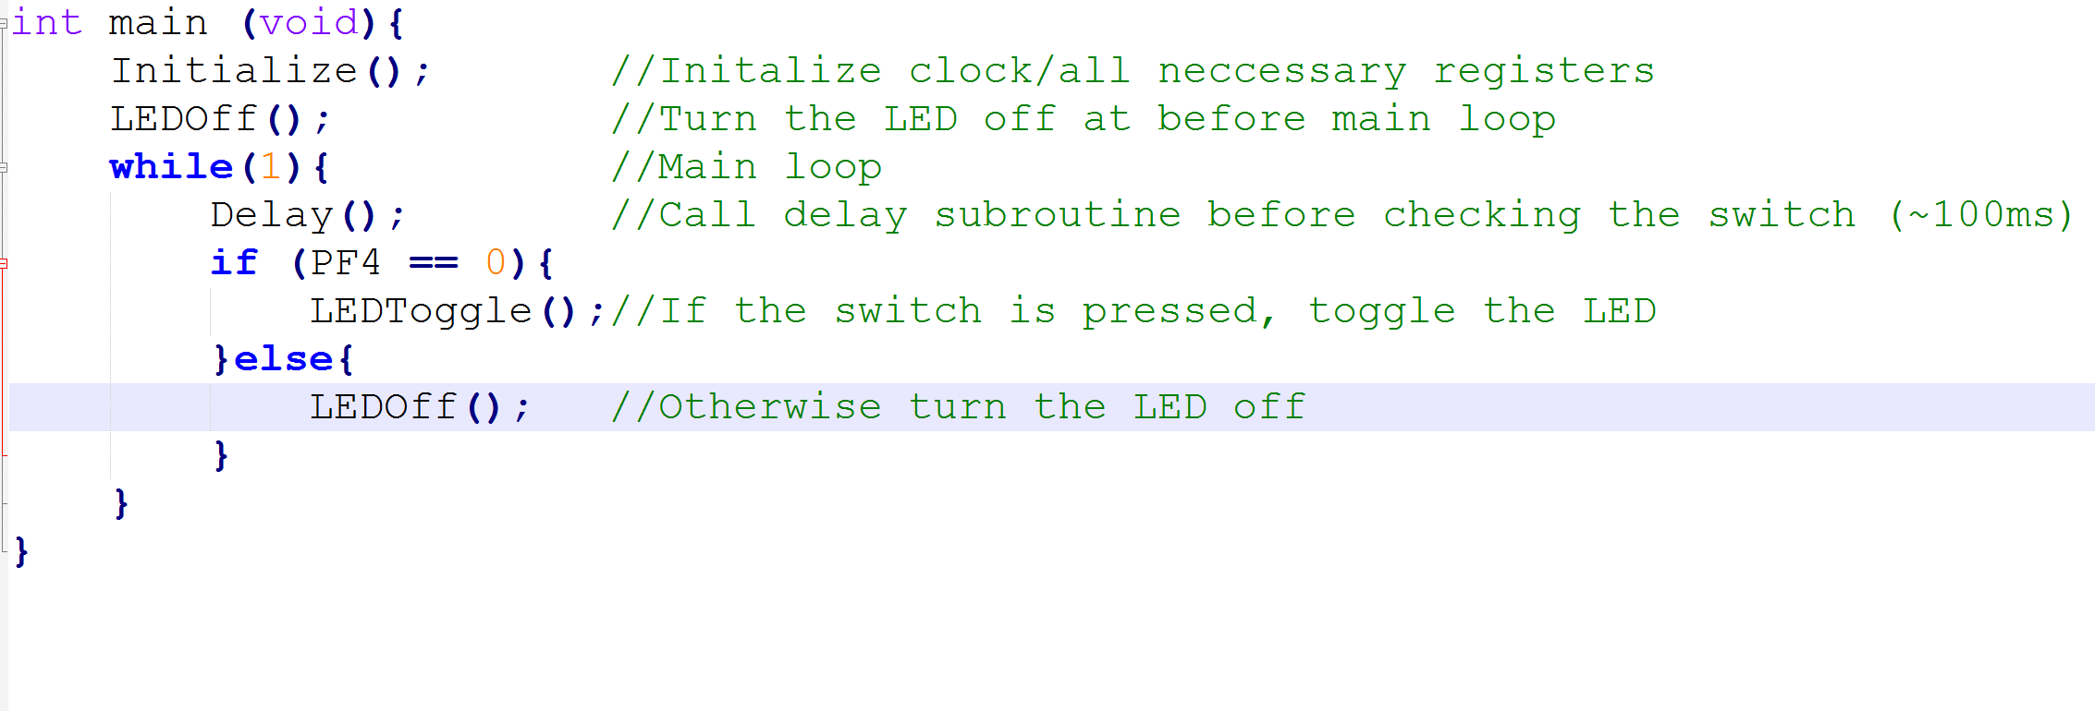
PROgram Flow (in C)

Slide 4
Negative Logic
PF4 is negative logic based:
Reads a high (1) when switch is not pressed
Reads a low (0) when switch is pressed
Must set the Pull Up Resistor for PF4
Set Bit 4 of GPIO_PORTF_PUR_R

Slide 5
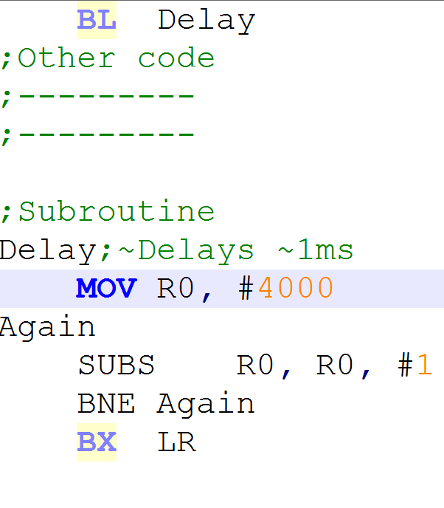
Subroutines/Conditionals
Use BL (subroutine label) to call your subroutine
To return to the caller, write BX LR at the end of your subroutine
Set condition codes when using conditional branches (SUBS, ADDS, ANDS, etc or use CMP)

Slide 6
Determining Your Delay Value
Number of loop iterations = (Frequency cycles/s) * (time(s)) * (1 loop iteration/ n cycles)
Majority of instructions take one clock cycle; branches take 3 cycles (2cycles on hardware) when the branch is taken

Slide 7
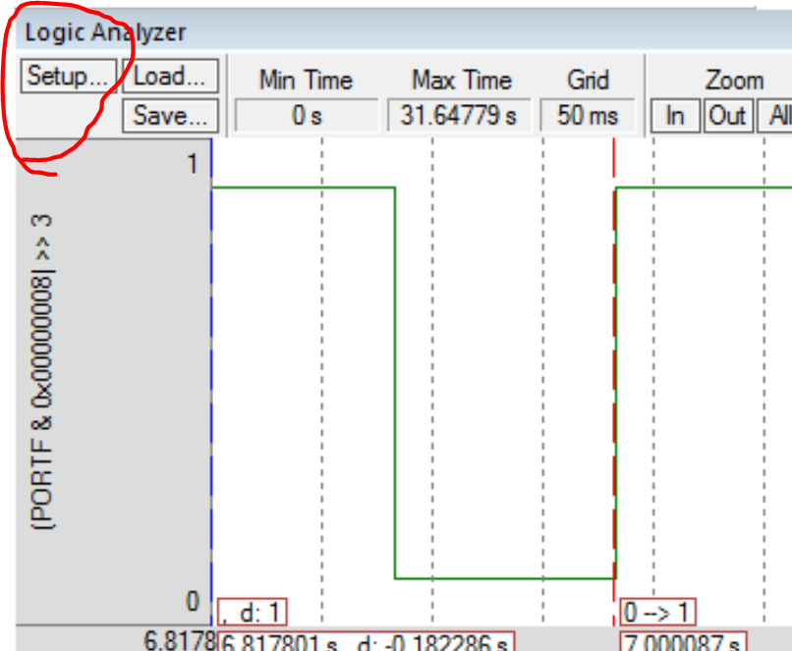
Using the logic analyzer
Show the Logic Analyzer by going into debug mode > View > Analysis Windows > Logic Analyzer
Set the Pin to view by clicking “Setup” in top left hand corner of the Logic Analyzer

Slide 8
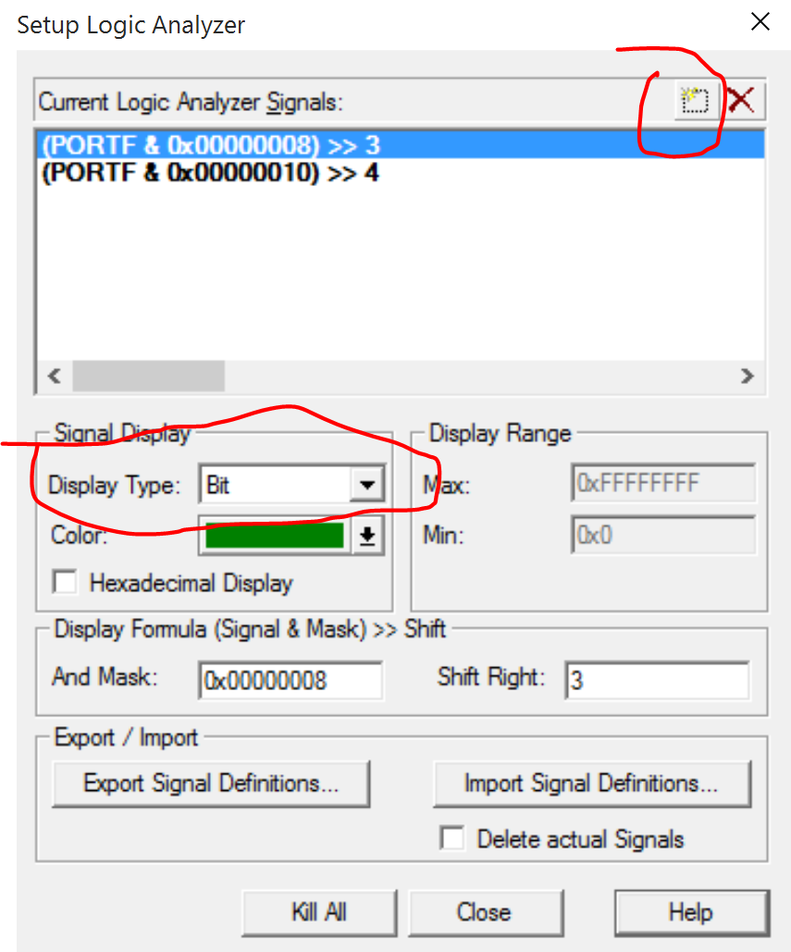
Using the logic Analyzer
In setup, click the circled button at the top right, then type “PORTF.3” (output) hit enter, and follow the same steps to add “PORTF.4” (input). Also change the display type to “Bit”
Close afterwards

Slide 9
Using the LOGIC analyzer
Zoom out to get a better view of the signal
Select the cursor option
Left click to set a reference point (red dotted line)
Move your mouse cursor (which will have a dotted blue line), a small red rectangle will tell you the time elapsed between your reference point and your current cursor position
You will need to verify the LED toggling rate using the Logic Analyzer
Show using the logic analyzer when the input signal is low the LED is toggling and vice versa (check lab manual for screenshot examples)

Slide 10
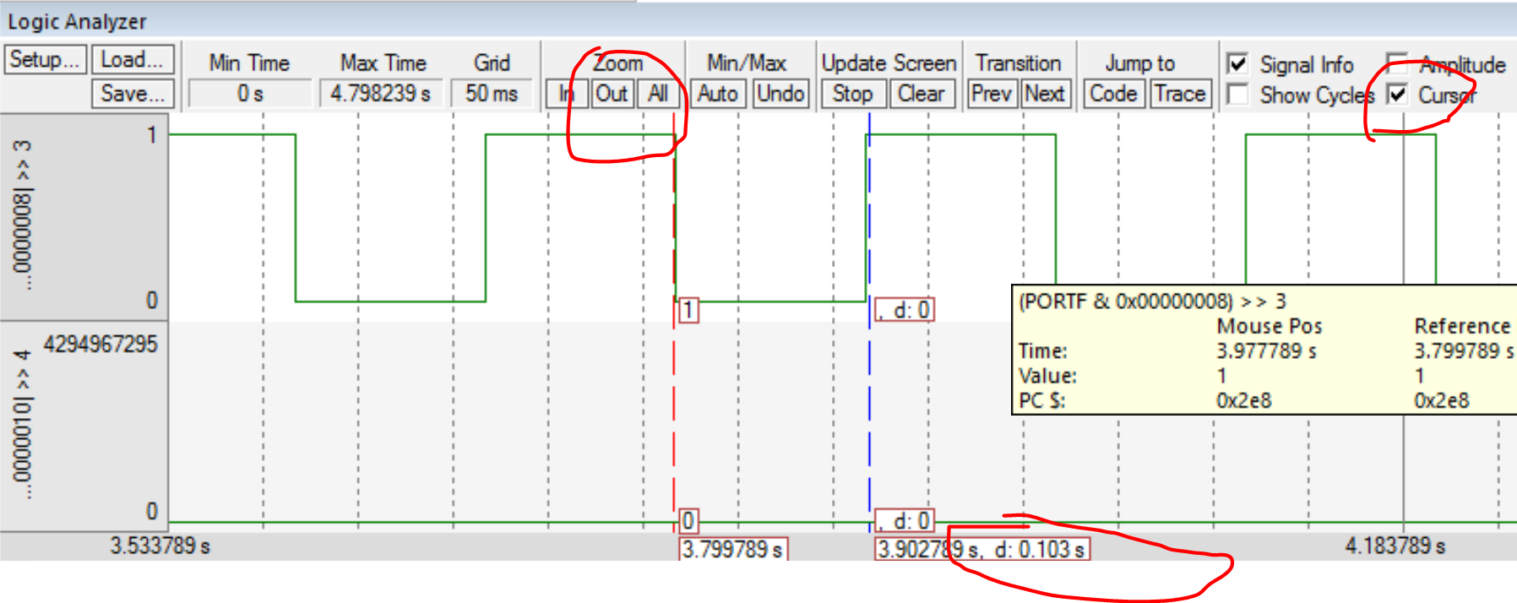
Using the logic analyzer

Slide 11
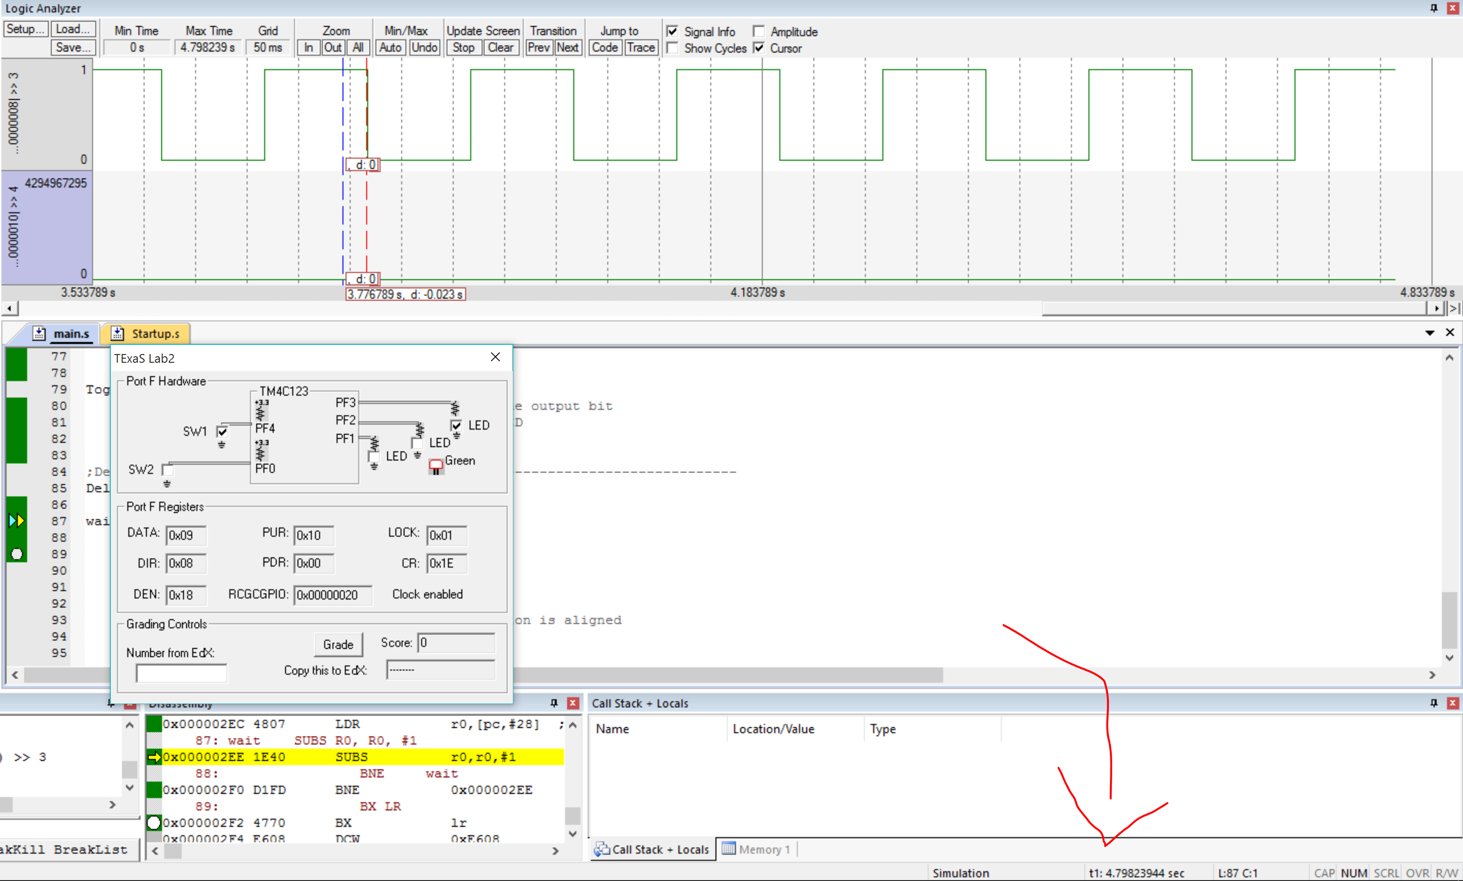
Simulation Timing
You will need to record how much time is simulated in 10s of real time (measured with a stopwatch)
Time simulated is shown at the bottom right of Keil (or you can use the cursor in the Logic Analyzer)

Slide 12
DELIVERABLES
Lab 2 Grading Sheet – be sure to study the vocab/theory questions listed in the demonstration section
Flow chart and pseudocode (one PDF)
2 Logic analyzer screenshots (one showing when the switch is not pressed, and the other showing the LED toggling), verify the LED toggle time as well
Assembly source code
Simulation time in 10 seconds real time

